Slide 1

Notes:
Zaryab

Slide 2

Notes:
Z

Slide 3
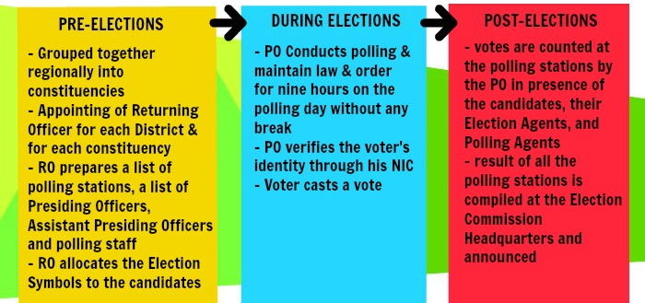
In the present electoral system of Pakistan, the National Assembly is elected directly by the people of Pakistan. The Election Commission of Pakistan is a constitutionally established institution responsible for holding elections countrywide. The diagram below shows how the commission holds an election in the country.
Notes:
Z

Slide 4
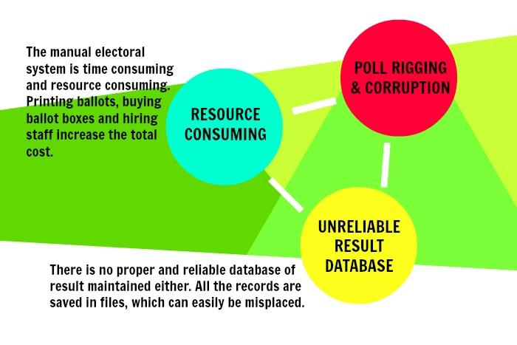
Notes:
Z

Slide 5

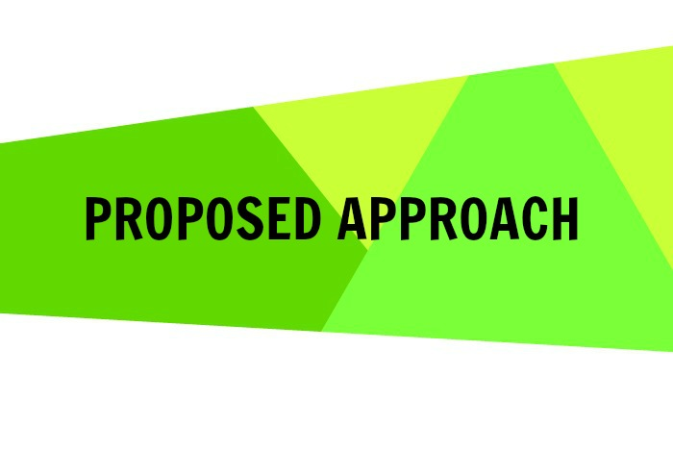
Notes:
A

Slide 6

1) Vote Dou is a project that could help the Pakistani electoral system get rid of corruption and rigging by replacing the ballot paper with a computer connected to the Vote Dou database that can record a voter’s vote and send the information over to the database.
2) The software not only helps cast electronic votes but it also helps to set up elections, manage constituencies, manage the candidates contesting on these constituencies and determine the results on the Election Day.
3) The GUI will be user friendly allowing the uneducated voters to easily cast their votes too.
4) The voters, election commission officers and database administrator will have different access rights defined according to their roles.
Vote Dou 1.0 is an electronic voting system that will automate the process of casting a vote and counting votes. It is presented as an alternative to the existing parliamentary voting procedure present in Pakistan.
Notes:
A

Slide 7

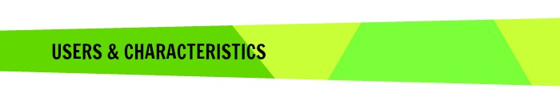


There are three types of users that will operate the software as follows. Each of these users will be provided a username and password to access the system.
The database administrator - The DBA plays the administrative role in the system. He manages the election details in the database and grants different access rights to users. He is entrusted with the job of inserting details about the election candidates, the eligible voters and the constituencies.
The election officer -The election commission can filter the results by Constituency or Party Name and generate a report to announce results.
The Voter - The voter shall login into the system using his CNIC number. If verified, he can cast a vote and submit it. Every voter can cast only one vote.
Notes:
A

Slide 8
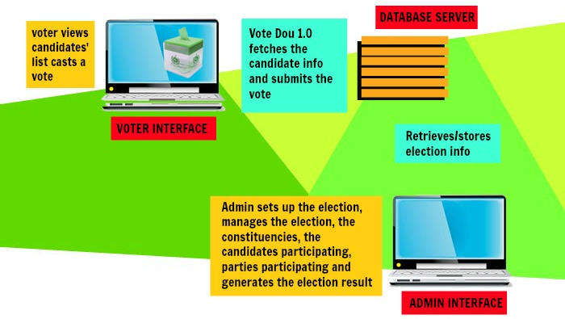
Vote Dou is based on the idea that a computer integrated to the Vote Dou database will be set up at each polling booth where the voters will vote their candidates participating from their respective constituencies.
The diagram illustrates how the system interacts with its external environment and the way the system is put to use.
Notes:
A

Slide 9
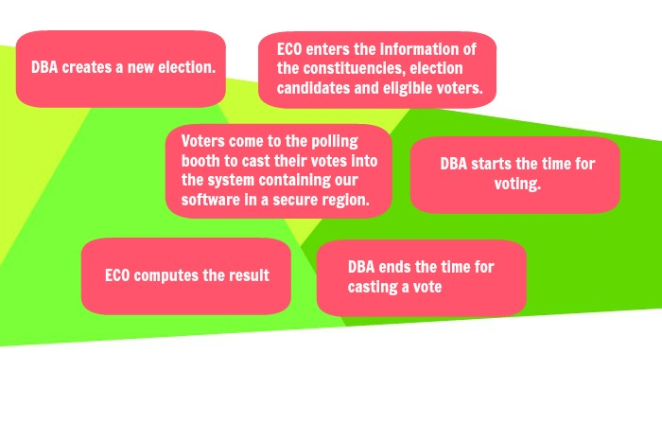
The Diagram of the system shows how the election shall proceed with Vote Dou and how the system functions relate to each other.
Notes:
N

Slide 10

Notes:
G

Slide 11
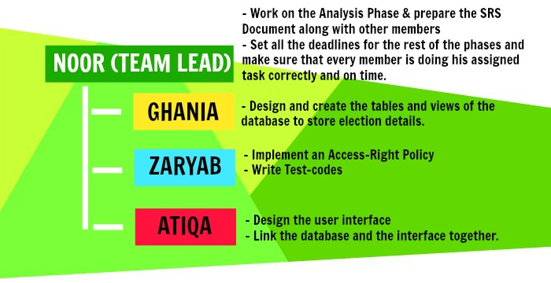
Our proposed database project is to provide a set of reliable, easy-to-use and secure tools that allow voters to cast ballots while the election commission collects votes and outputs the final result. Each of our four team members will work on one of these aspects.
Notes:
G

Slide 12
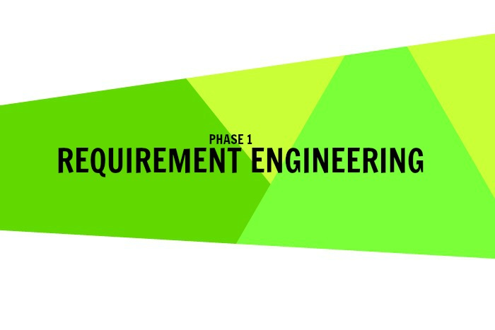
Notes:
G

Slide 13
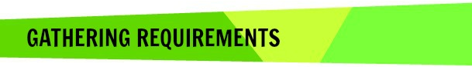
Our Requirement engineering process involved scenarios and ethnography to find out about the application domain, the services that the system should provide and the system’s operational constraints. The developers of the system have themselves voted in their respective constituencies in Elections 2013 and through ethnography, they have already gathered the requirement abstraction of the system.
Once the process of Requirement gathering was complete, the team prepared the SRS document specifying the functional and non-functional requirements and the System Constraints in more detail
Notes:
G

Slide 14
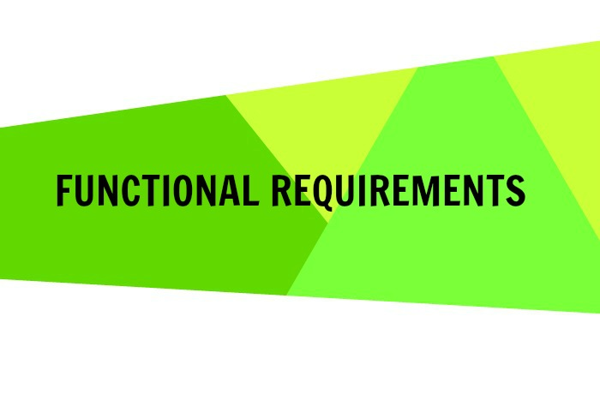

Slide 15
Vote Dou 1.0 provides a set of tools that allow voters to cast ballots while the election commission collects votes and outputs the final result. It performs the following functions:
User identity authentication at login & Access Right Policy.
Logging in to the Vote Dou software shall require user identity authentication. The system should be password protected with utmost care being taken by the ECO, ensuring that the passwords are provided only to the required individuals. As an improvement to the user identity authentication process, Fingerprint of the users can be scanned to log in to the system. The scanned finger prints is matched against the finger print of the specific individual stored in the NADRA database. A scanning device is needed to acquire the finger print and will be connected to the voting terminal that runs Vote Dou.

Slide 16
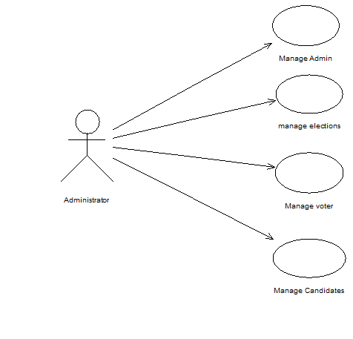
2) Pre-voting phase Requirements
In the pre-voting phase the database administrator (DBA) creates a new election and enters the information of the constituencies, election candidates and eligible voters using the information provided by the Election Commission of Pakistan. This phase constitutes of a number of functionalities as shown in the use case:

Slide 17
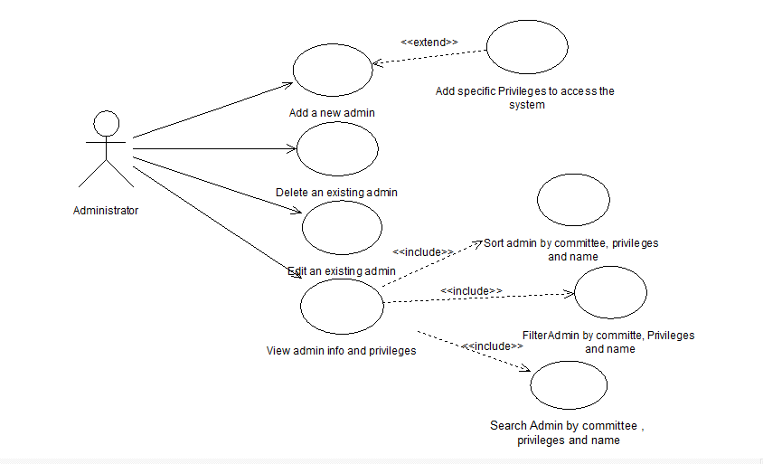
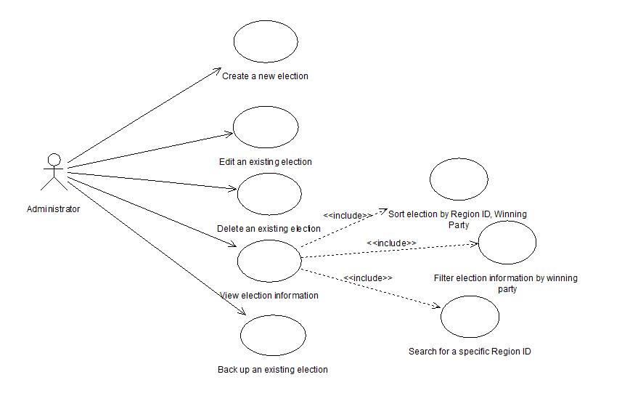
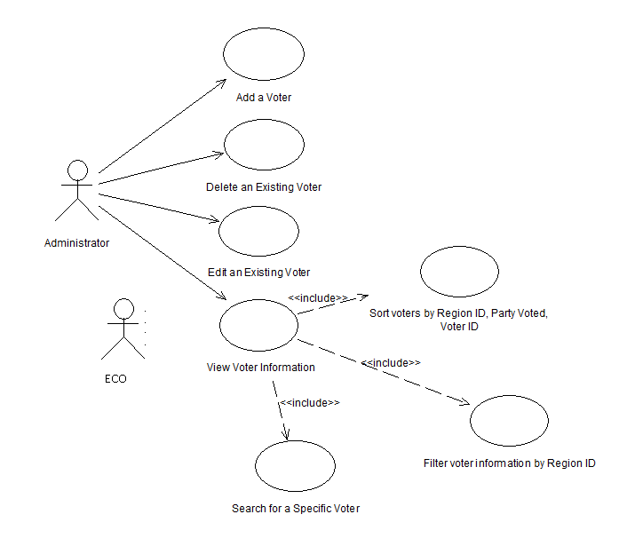
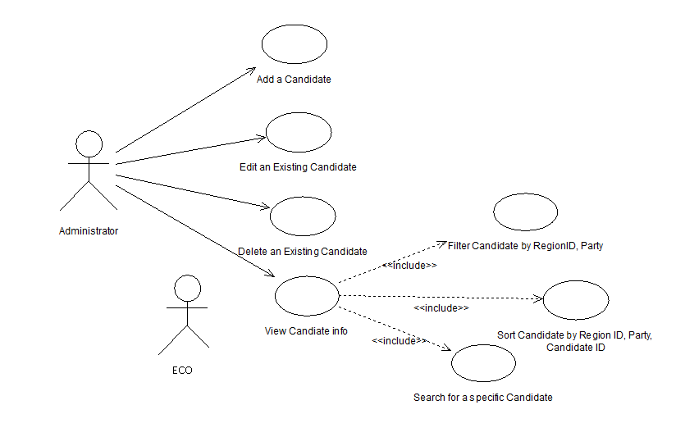
The Manage Administrator Module
The Manage Elections Module
The Manage Candidate Module
The Manage Voter Module

Slide 18
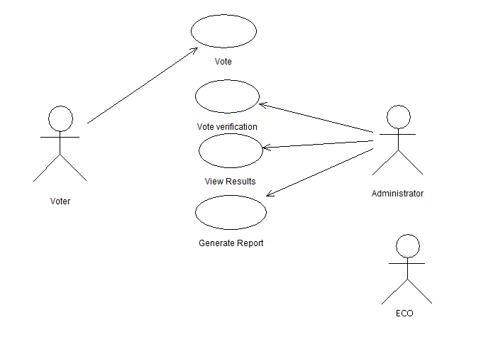
3) Voting & Post-Voting phase Requirements
In the voting phase,
the database administrator starts the time for voting.
Voters come to the polling booth to cast their votes into the system containing our software in a secure region.
Eventually,
the database administrator ends the time for casting a vote.
It provides the Election Commission officer with a user-friendly interface to view the election information and compute the results. The officer can filter the results by Constituency or Party Name and generate a report to announce results.

Slide 19
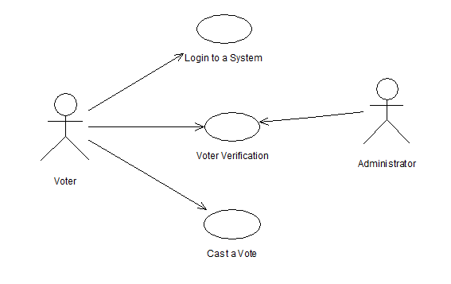
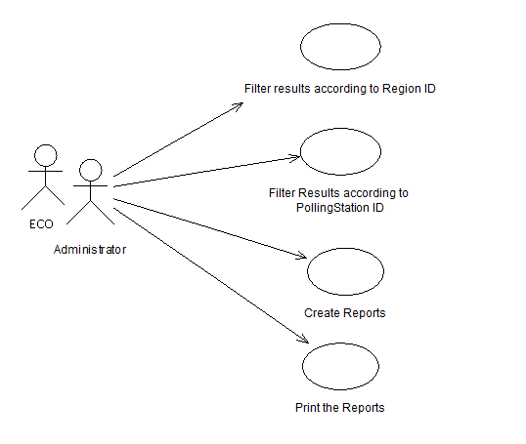
Submit a Vote Module
Result Management Module

Slide 20
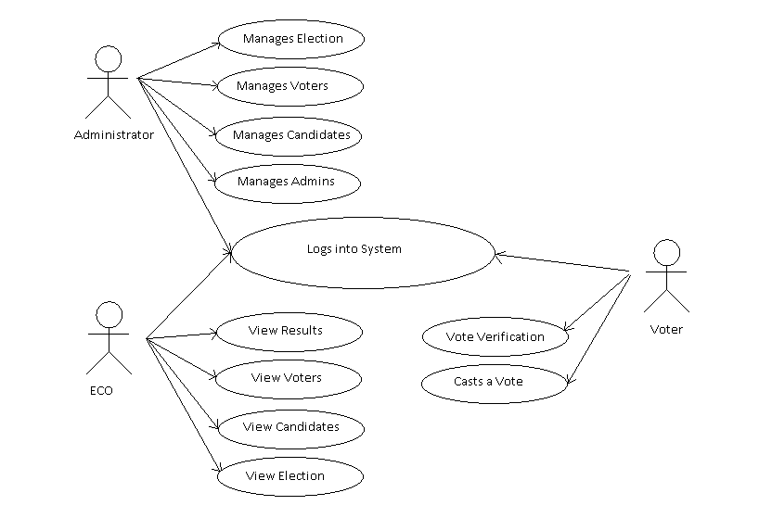
The following use case diagram encapsulates the entire system and all possible actors.

Slide 21
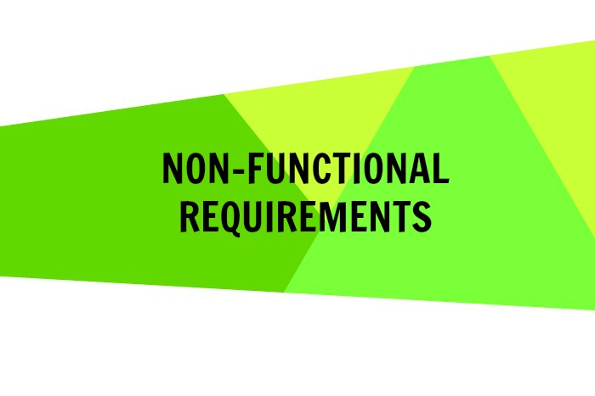

Slide 22
Performance Requirements
Time is a key factor on the polling day as there are thousands of voters waiting for their turn to vote on the polling day. The system should be responsive and hence the following measures should be taken:
It should not take more than 1 second for the system to direct the user to another page.
The login time should not exceed more than 3 seconds.
The scanning of thumb prints should recognize the correct user within 5 seconds of scanning.
The Vote Dou software should update the election results every 10 minutes which would determine the leading candidates from the different constituencies on the Election Day.
The voting time should strictly follow the schedule of voting hours after which the voters will not be allowed to vote.
The Vote Dou software should be compatible with windows 7 and windows 8 and should not require more than 300mb of hard disk space, 1 GB ram, and a dual core 1 GHz processor.
The database should have sufficient memory so as to store all of the data necessary. This may vary with the scope of use of the product.

Slide 23
2. Safety and Security Requirements
We considered the possible loss that could result from the product use. This included password leak, hacking and i-voting.
Vote Dou must not violate the ISO security standards and it must be in compliance with the ACM/IEEE ethical standards.
Password protected login. Password to be provided to each user with different access rights according to the roles of the Administrator, Election Commission Officer and the Voter. (Requirement)
The passwords generated should contain a minimum of 7 alpha-numeric characters.
Integrating a finger scanning device with the software that checks the user’s finger print against the finger print of the user that is stored in the NADRA database. (Recommended)
Complete protection to safeguard the data against malicious users that may attempt to hack into the database and manipulate the election results. Experts in security and hacking must be asked to check for any loop holes in the security.
Notes:
POSSIBLE LOSS THAT COULD RESULT FROM PRODUCT USE
If the login process is not password protected, the validity of a person’s vote will not be ensured. Hence, Logging in to the Vote Dou software shall require user identity authentication. The system should be password protected with utmost care being taken by the ECO, ensuring that the passwords are provided only to the required individuals. As an improvement to the user identity authentication process, Fingerprint of the users can be scanned to log in to the system. The scanned finger prints is matched against the finger print of the specific individual stored in the NADRA database. A scanning device is needed to acquire the finger print and will be connected to the voting terminal that’s runs Vote Dou.
If the database is hacked, confidential information about the voter can be leaked or fake votes can be casted. Hence, Preventive measures should be taken to ensure that hacking into the Vote Dou database is impossible.
Vote Dou shall not allow i-voting. I-voting is voting from one's personal computer, mobile phone, television via the internet. As i-voting doesn’t ensure the validity of a person’s vote, the Vote Dou

Slide 24
3) Software Quality Attributes
RELIABILITY: The system’s availability and data integrity cannot be jeopardized at any cost
ROBUSTNESS: It is crucial that the system does not produce unwanted results in the case of a system failure
ADAPTABILITY: As there will be both educated people and uneducated people using the software, it is very important that the software provides a simple user interface.
MAINTAINABILITY: Vote Dou 1.0 must be designed and implemented in such a manner that it is adaptable to both software and hardware upgrades.
Notes:
Software Quality Attributes
RELIABILITY
The system’s availability and data integrity cannot be jeopardized at any cost. As the system plays a very significant role in the national elections, a system crash means that the software is unavailable to cast and submit a vote at a polling station. This will affect the whole voting process and cause inconvenience to both the voters and the election commission officers. Hence, the system must be properly tested using validation and defect checks and all the errors should be debugged. The mean time to failure should not be less than 2400 hours.
It is very important that that the software ensures data integrity as well. All database transactions must be carried out using COMMIT and ROLLBACK statements and locking to ensure data consistency. Moreover, a complete protection must be provided to safeguard the data against malicious users that may attempt to hack into the database and manipulate the election results. Experts in security and hacking must be asked to check for any loop holes in the security.
ROBUSTNESS
It is crucial that the system does not produce unwanted results in the case of a system failure. In case of a failure, all processing transactions should be rolled back and there should be no loss of information or data corruption in any situation. The probability for data corruption on failure should be 0. It should not take more than 5 minutes for the system to restart in case of a failure (preferably 3 minutes) as time plays an important part in the process of an election.
During the testing phase, test cases should be modeled to perform defect testing using correct inputs, extreme inputs (maximum/minimum values) and incorrect data with known errors. This will check how the system will cope with errors during execution.
ADAPTABILITY
Vote Dou 1.0 will be presented as an alternative to the existing parliamentary voting procedure present in Pakistan. Hence, its adaptability to the working domain is significant. As there will be both educated people and uneducated people using the software, it is very important that the software provides a simple user interface. The interface must only demand basic operations such as entering the NIC number and clicking on the respective candidate of the constituency belonging to a certain party from both the national and provincial assemblies.
The voters will be using this software for the first time during the elections so it is necessary that the voters adapt to the system easily and quickly. They should not make a mistake while casting their votes electronically. The average number of people to make a successful poll before a voter error occurs should be 10000. The mean time taken for the voter to cast the vote after logging in should be 45 seconds.
MAINTAINABILITY
An important requirement is maintainability and evolution of the system. Vote Dou 1.0 must be designed and implemented in such a manner that it is adaptable to both software and hardware upgrades. Hardware upgrades may include scanning devices to implement the finger print security system. Software upgrades may include expanding the functionality or adding a firewall.
This flexibility to change can be implemented using classes and inheritance.

Slide 25
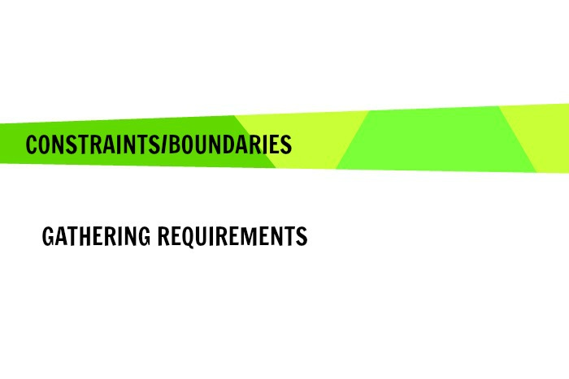
- Time Constraint: The system needs to be developed and tested in the month of December. Hence, the developer team has decided to use already learnt concepts of C# programming language to design the interface of the program and SQL to create the database.
- Security considerations: Vote Dou shall not allow i-voting. I-voting is voting from one's personal computer, mobile phone, television via the internet. As i-voting doesn’t ensure the validity of a person’s vote, the Vote Dou software shall not provide the facility of online voting. Polling booth shall be guarded with security personnel that would prevent any external threats from disrupting the process of voting.
-Hardware limitations: Vote Dou 1.0 is a working prototype implementation of the actual e-voting system. Presently, it cannot avail the finger print user authentication procedure to secure user logins due to unavailability of scanners. In the future versions, the development team can either utilize the scanning devices already available in the market or write a program to scan and match a picture captured using a digital camera.
Notes:
Z

Slide 26
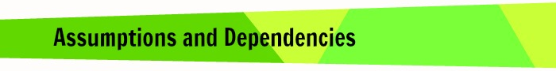
- It is assumed that NADRA shall provide the DBA with all the required information about the candidates and voters.
- It is assumed that the Election Commission of Pakistan will place a computer at every Polling booth.
- It is assumed that the Polling booths shall be guarded with security personnel that would prevent any external threats from disrupting the process of voting.
- It is assumed that Election Commission of Pakistan will recruit ECO who have know-how of the system. And it will be arrange orientation programs for newly recruited officers to help them understand the new system. The development team will provide an ECO Manual along with the product delivery.
Notes:
G

Slide 27
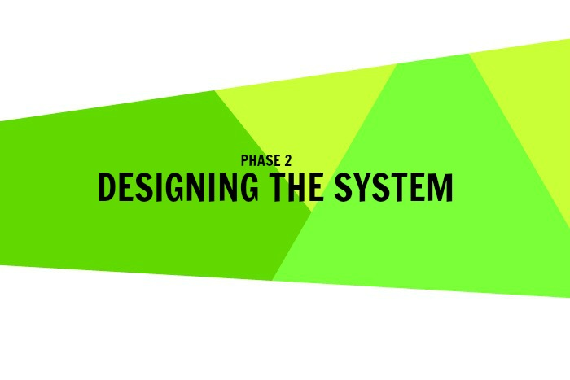
Notes:
N

Slide 28
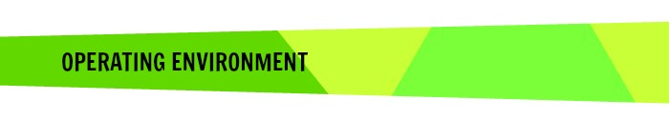
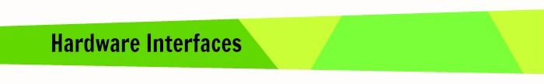
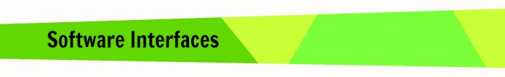
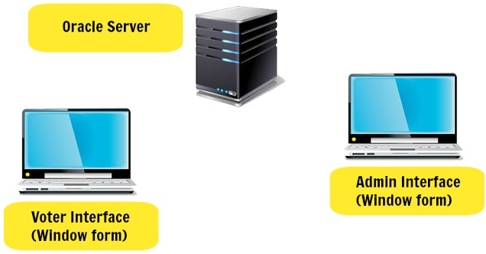
Vote Dou 1.0 will be implemented using C# Windows Forms at the frontend and SQL at the backend. Presently, the application can only be run on a computer with Windows Operating System. It doesn’t support other hardware platforms such as smartphones or tablets.
A simple diagram that shows the major components of the overall system and external interface is shown.
Notes:
Hardware:
Vote Dou 1.0 is composed of the following hardware interfaces:
At the polling stations, the Voter interface of the system is run on a client computer with 300mb of hard disk space, 1 GB ram, and a dual core 1 GHz processor. It must be accompanied by a Visual Display Screen, a typing device (i.e. Keyboard) and a pointing device (i.e. mouse or digital pen).
At the Election Stations, the Administrator/ECO Interface of the system is run on a computer.
The database is placed on the server computer. The database server should have sufficient memory so as to store all of the data necessary. This may vary with the scope of use of the product.
A scanning device must be installed at every polling station. (future implementation)
Software:
The software requirement for the development of Vote Dou 1.0 are Windows Operating System, Visual Studio 2013 (or previous versions) to design the windows forms using C# and SQL server management studio to create the database and store information.
Vote Dou 1.0 runs on a computer with the windows 7 and windows 8 Operating System.

Slide 29


Slide 30
The 4+1 View Architecture model is used to give an understanding of how and why the Vote Dou system is to be decomposed, and how the individual parts work together to provide the desired functionality. It separates the different aspects of a software system into different views of the system as follows:

Slide 31
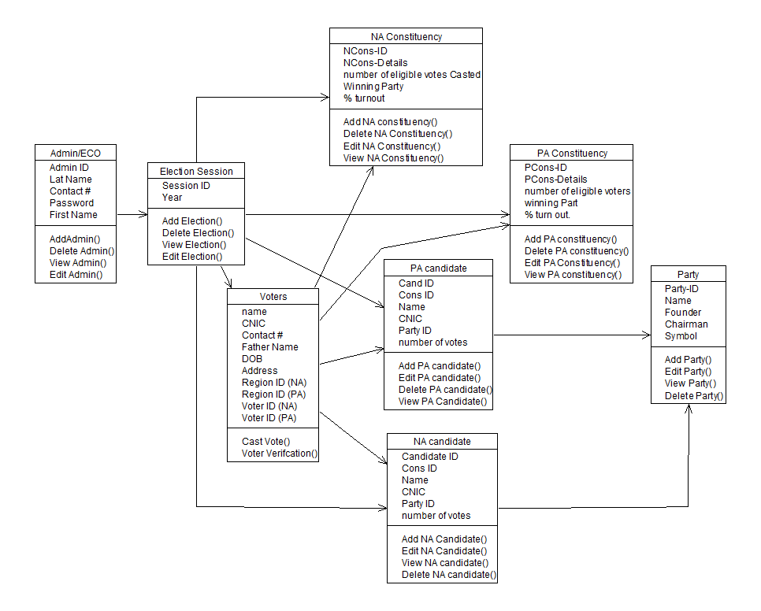
The logical view of the Vote Dou 1.0 I is modelled using the following class diagram and ER Diagram to show the key abstractions in the system

Slide 32
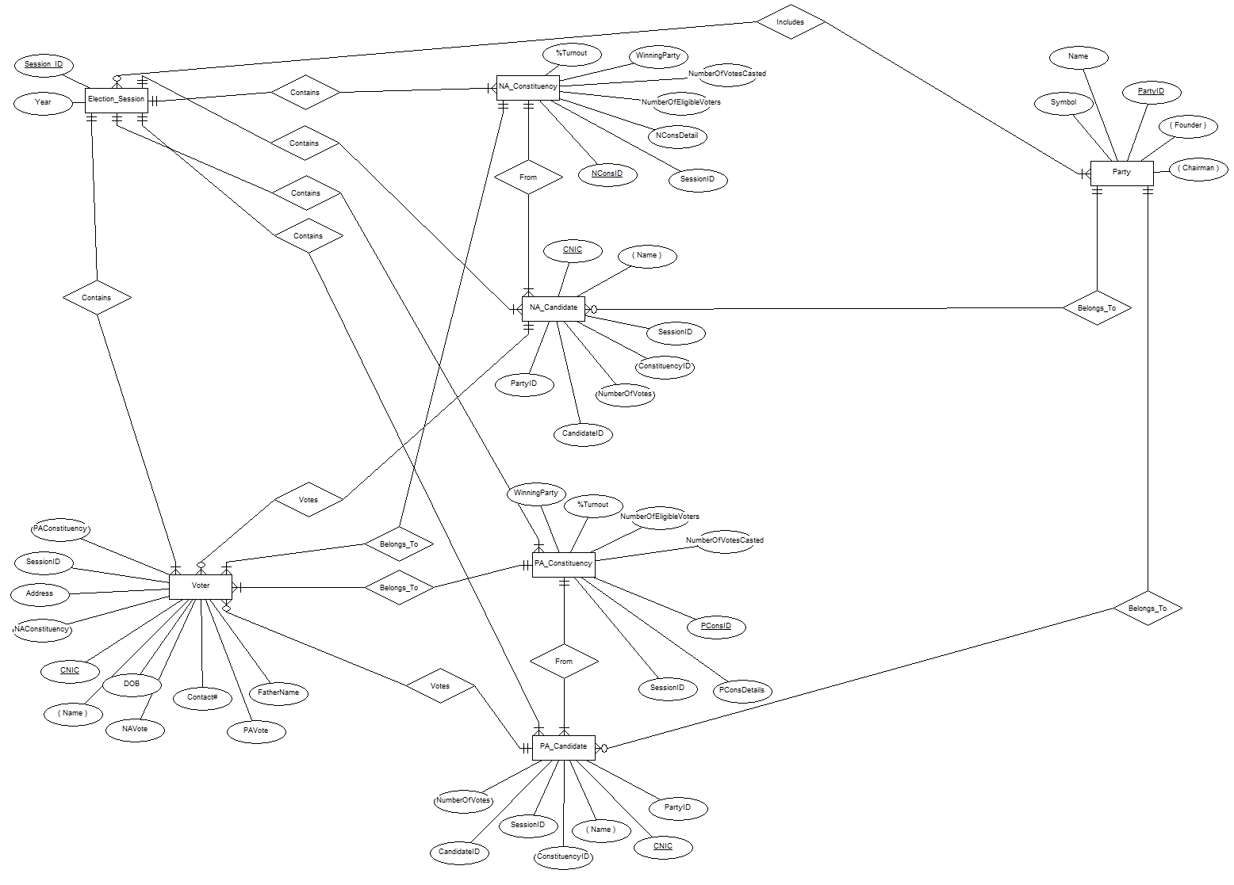
Entity Relationship Diagram

Slide 33
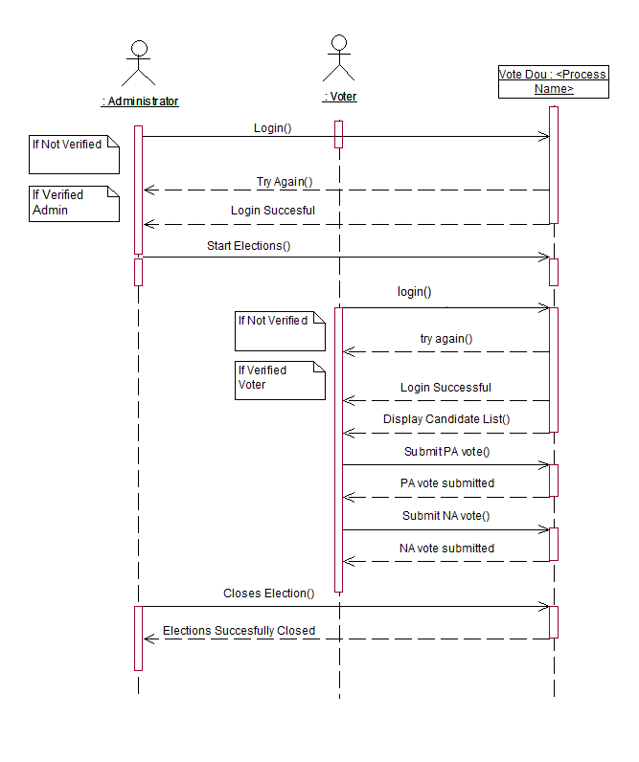
The process view of the Vote Dou 1.0 I is modelled using process diagrams, activity diagrams, state charts and sequence diagrams to show how, at run-time, the system is composed of interacting processes.

Slide 34
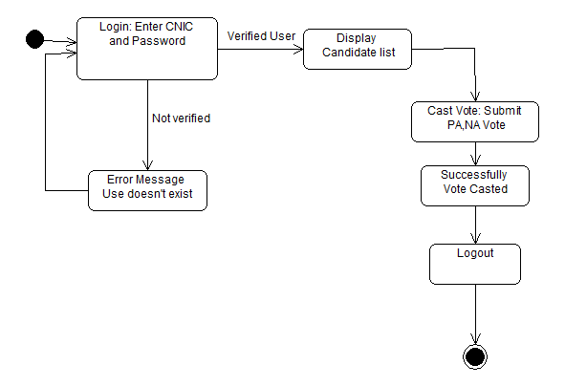
State Chart

Slide 35
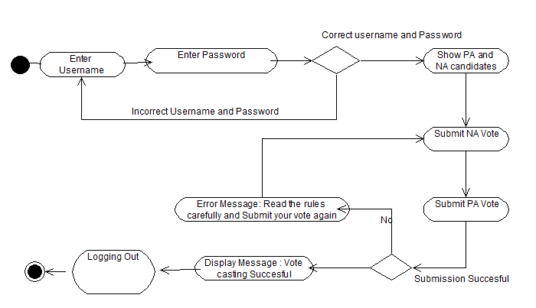
Activity Diagram

Slide 36
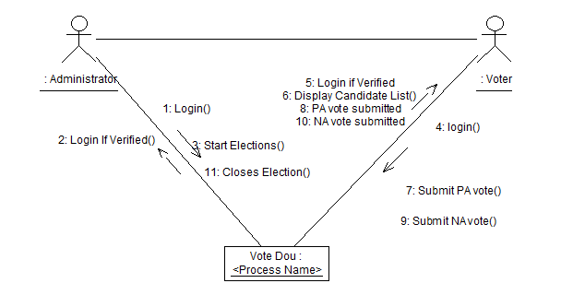
Collaboration Diagram

Slide 37
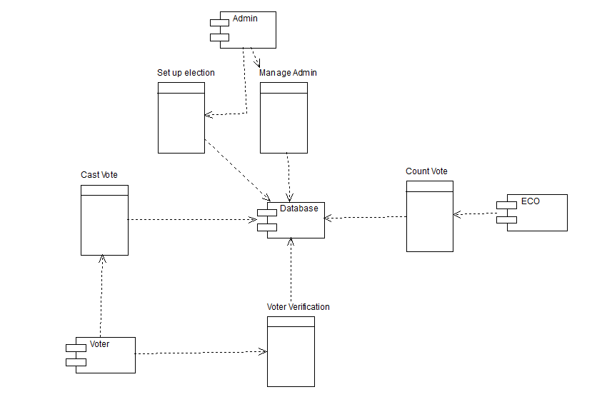
The development view of the Vote Dou 1.0 I is modelled using component diagrams to show how the software is decomposed for development.

Slide 38
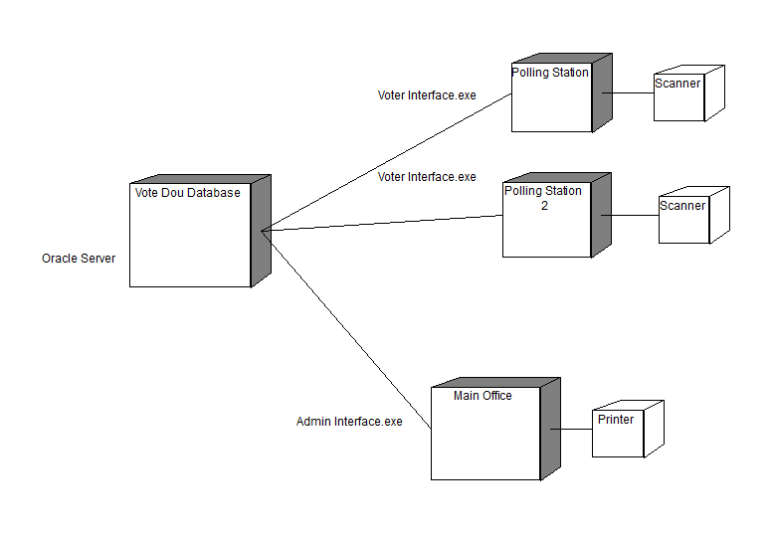
The physical view of the Vote Dou 1.0 I is modelled using a deployment diagram and server-client architecture model to show the system hardware and how software components are distributed across the processors in the system

Slide 39
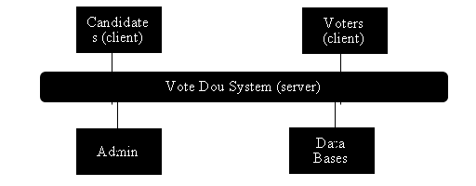
Client Server Architecture Model
The Vote Dou software will be distributed over a network of clients connected to a central computer, known as a server where the database shall reside. The database administrator, election commission officer and the voter will login to the system from different locations and all of the users will be accessing the database concurrently. The SQL Server shall handle the concurrent requests of several users into the database effectively

Slide 40


Slide 41
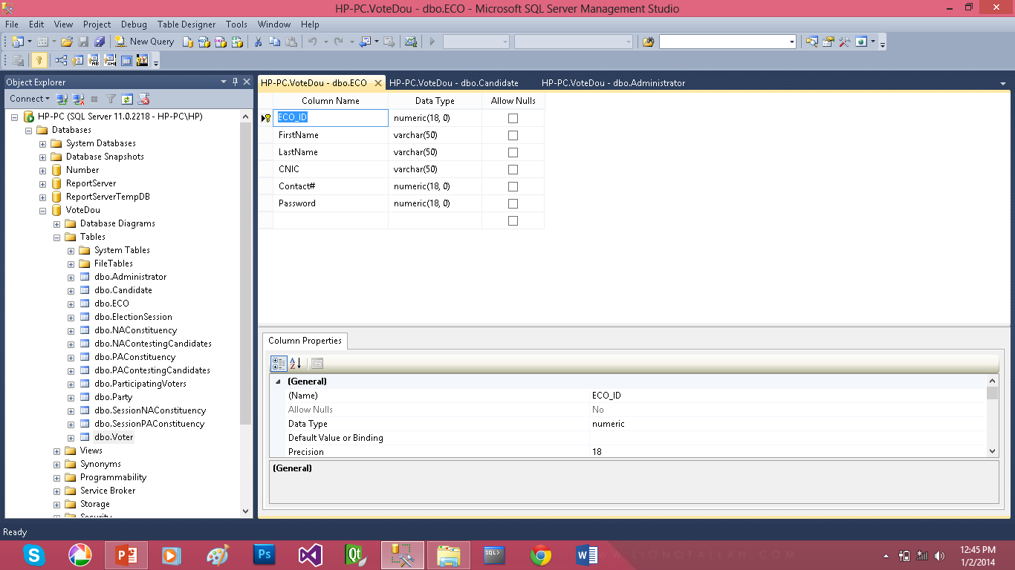
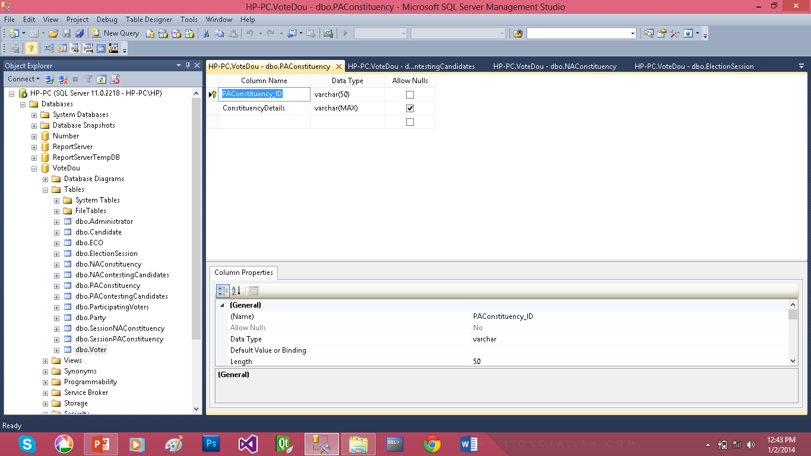

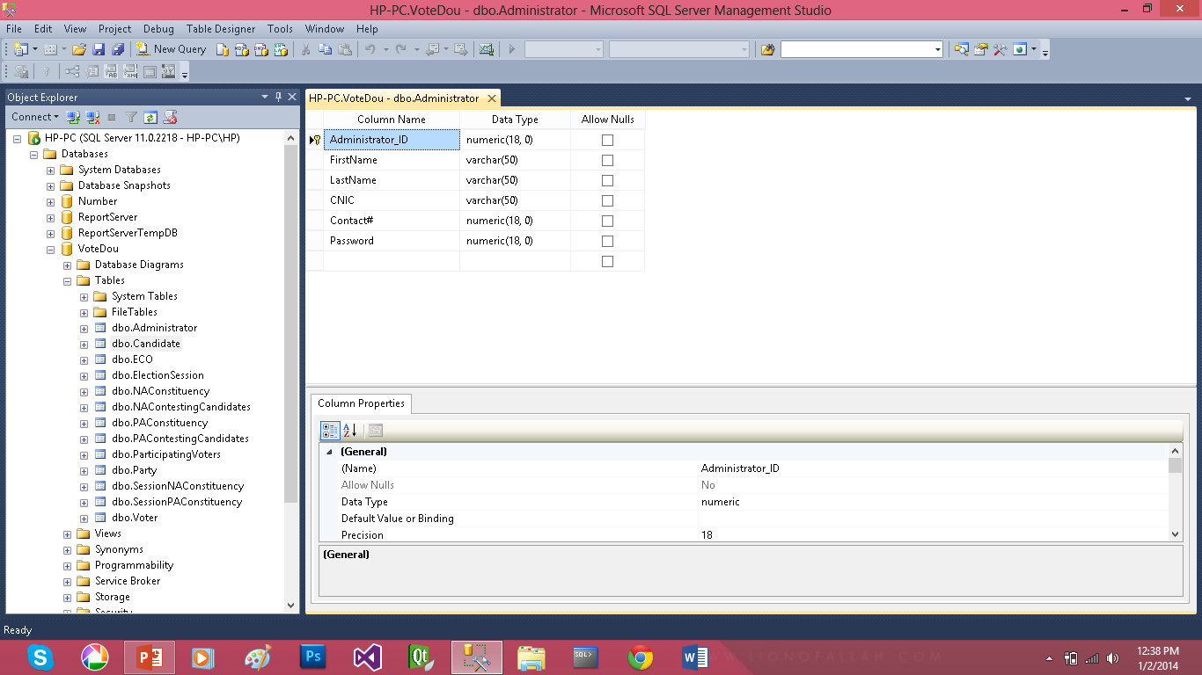

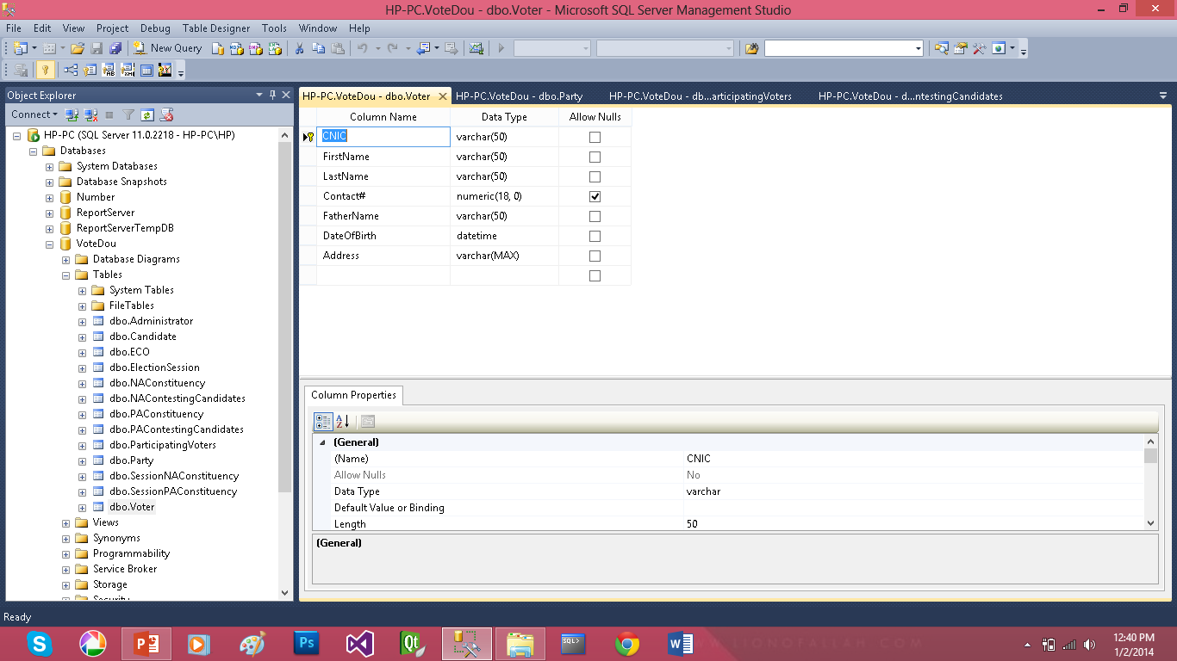

Main Tables

Slide 42
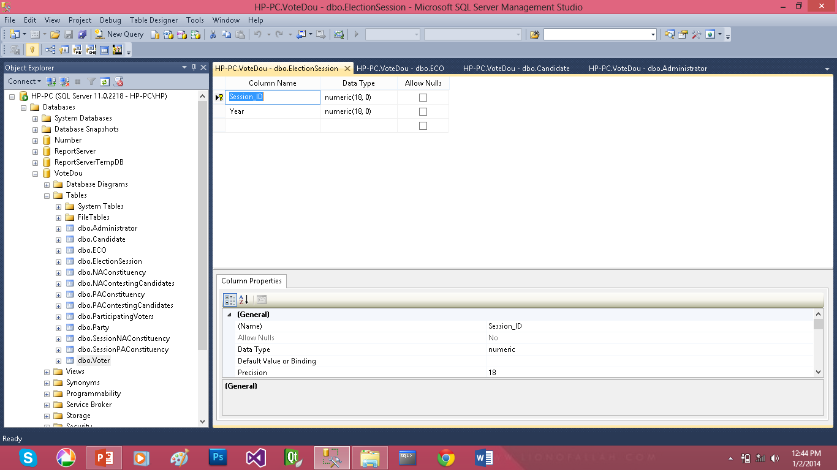
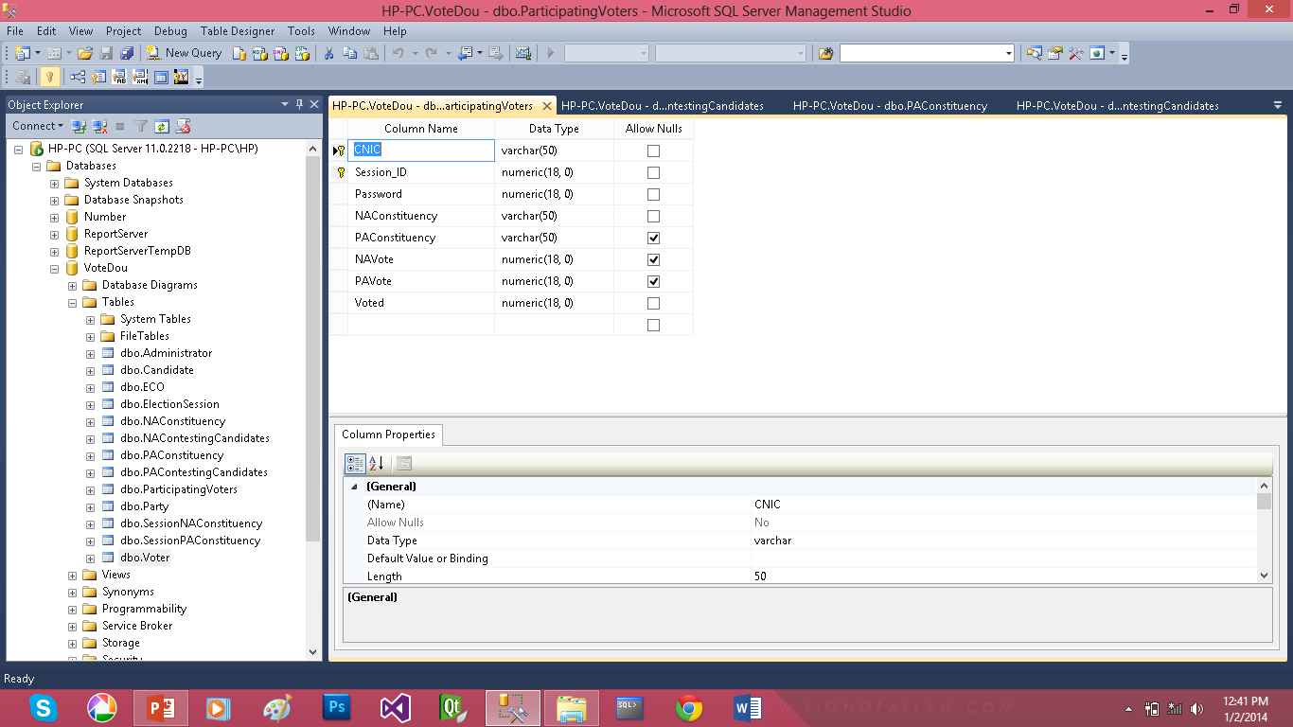
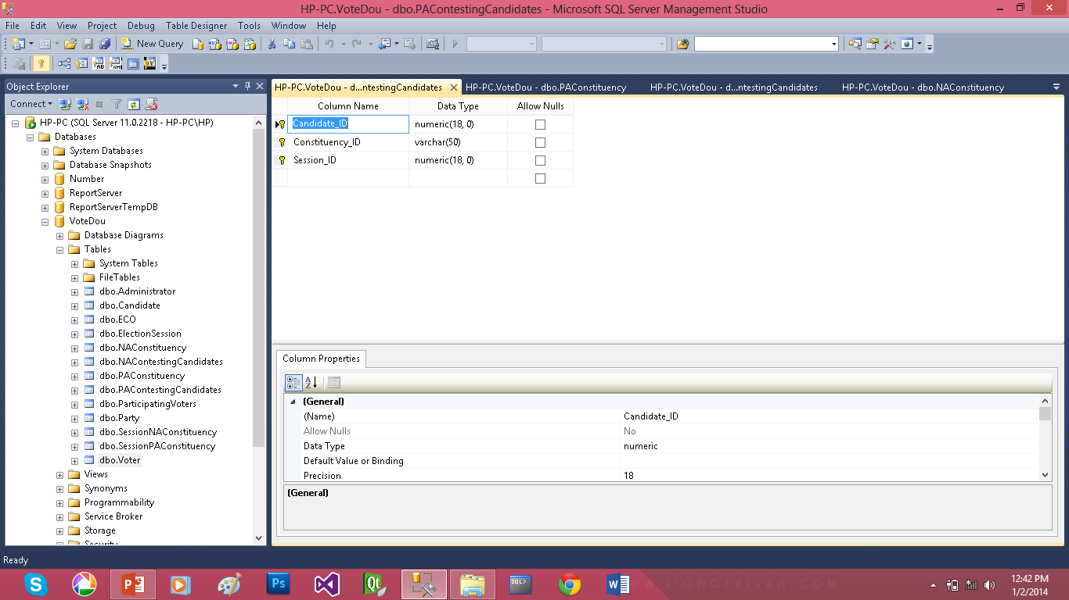
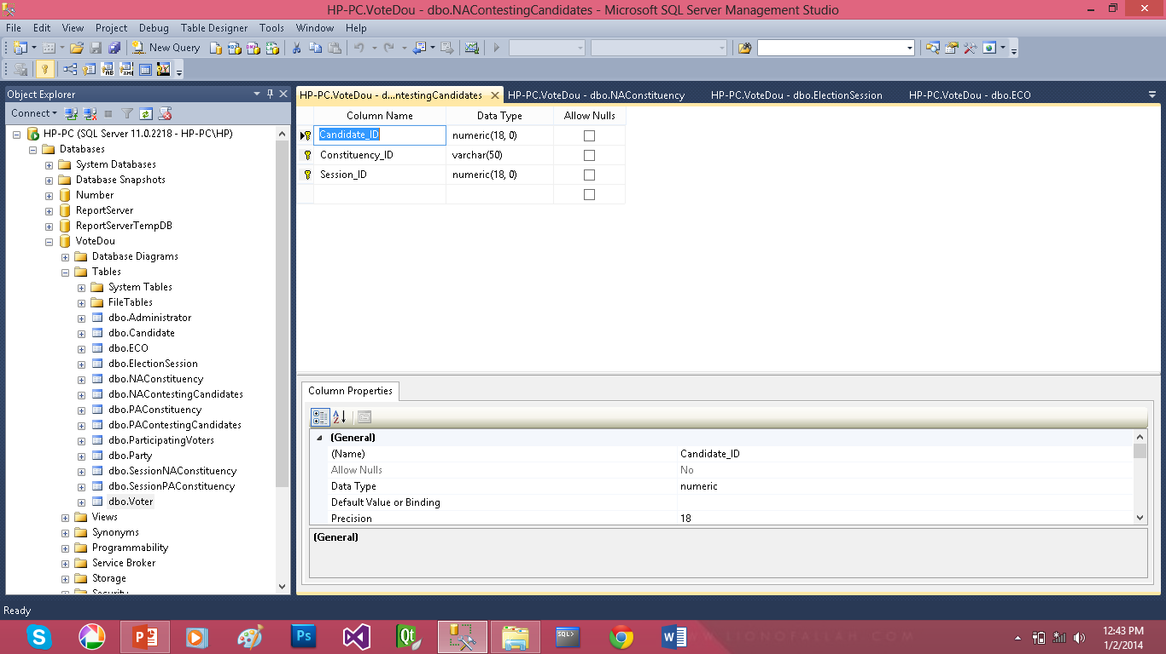
Transaction Tables

Slide 43


Slide 44
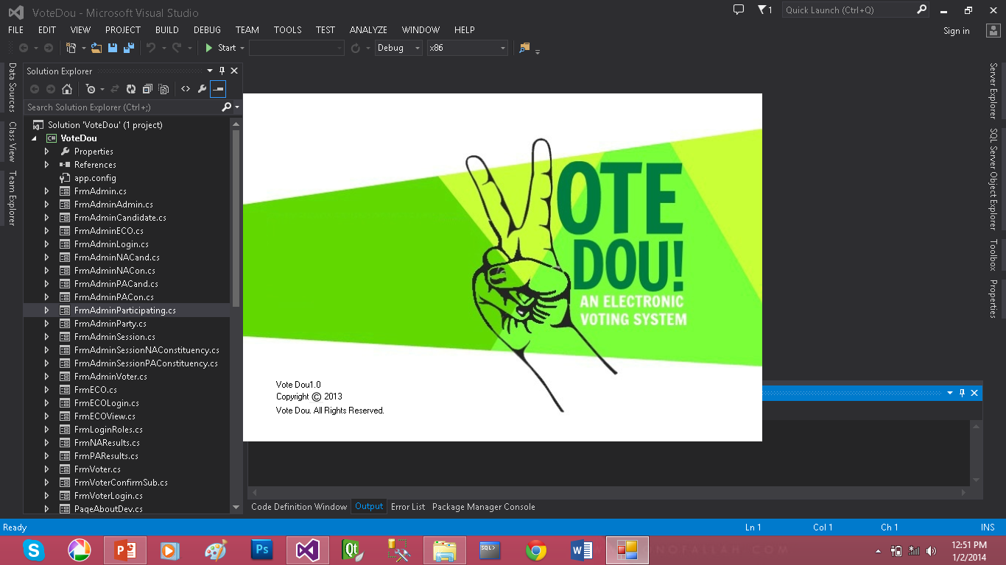
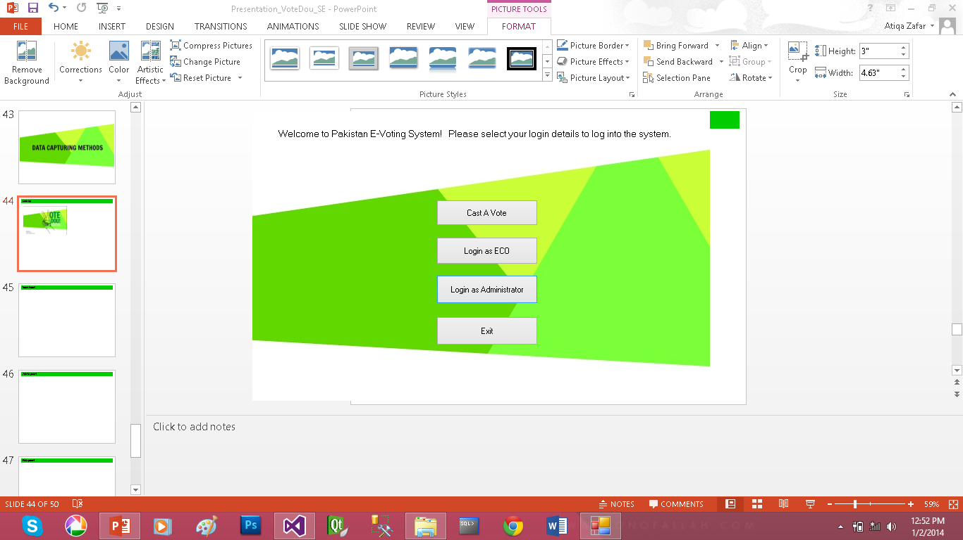
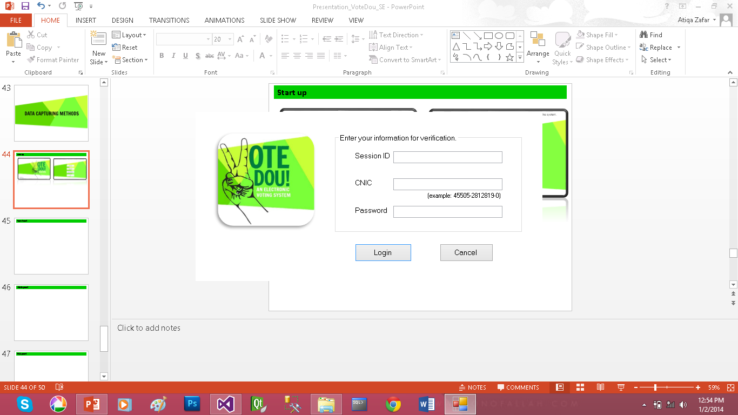
Start up

Slide 45
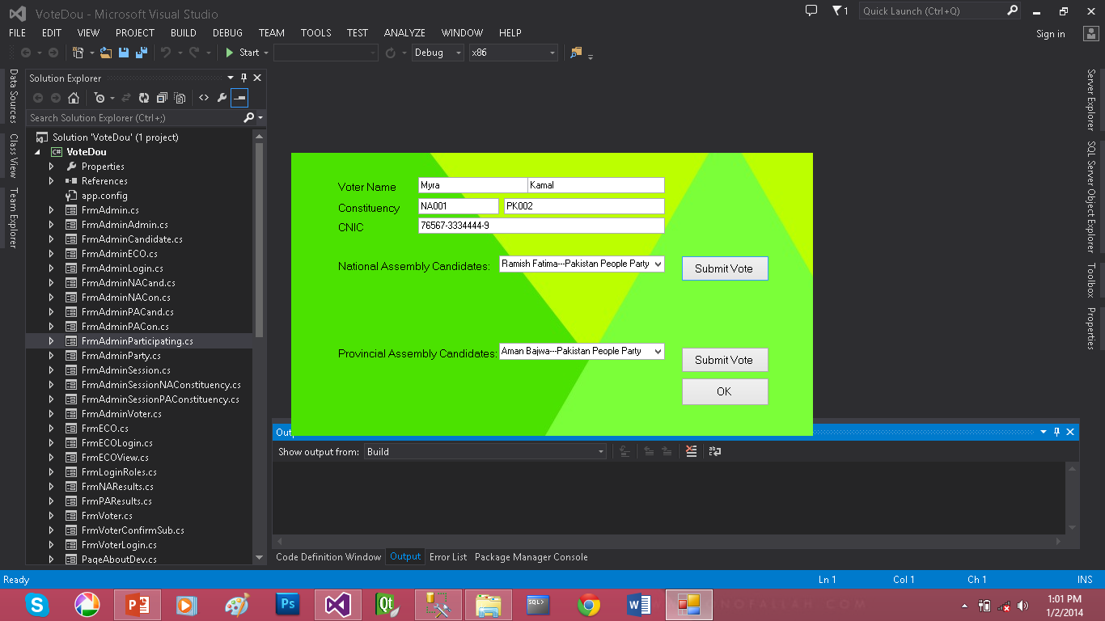
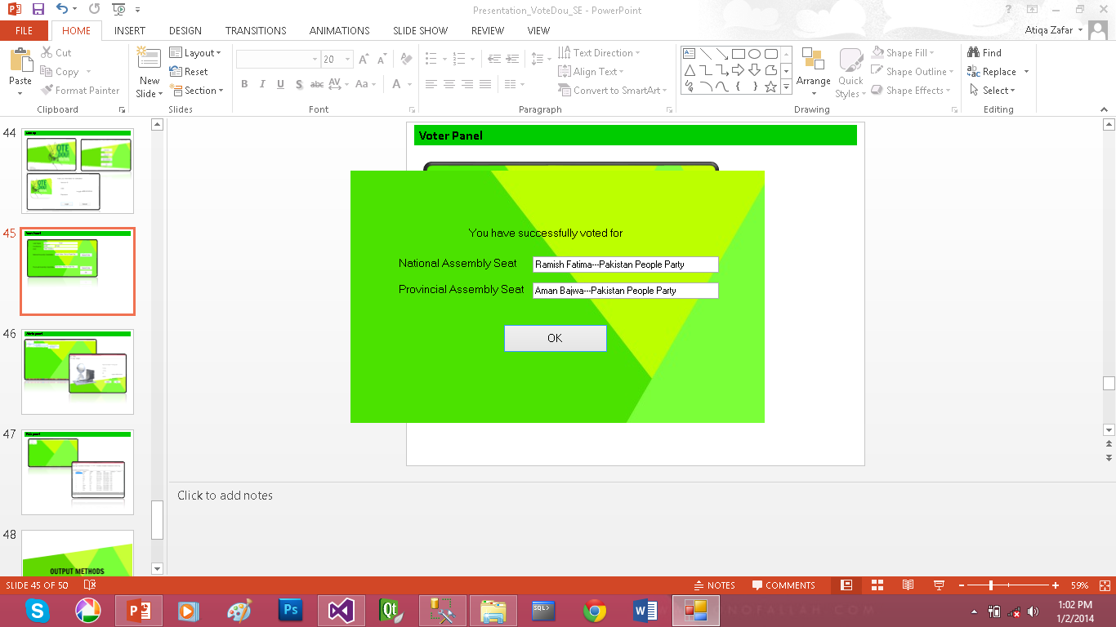
Voter Panel

Slide 46
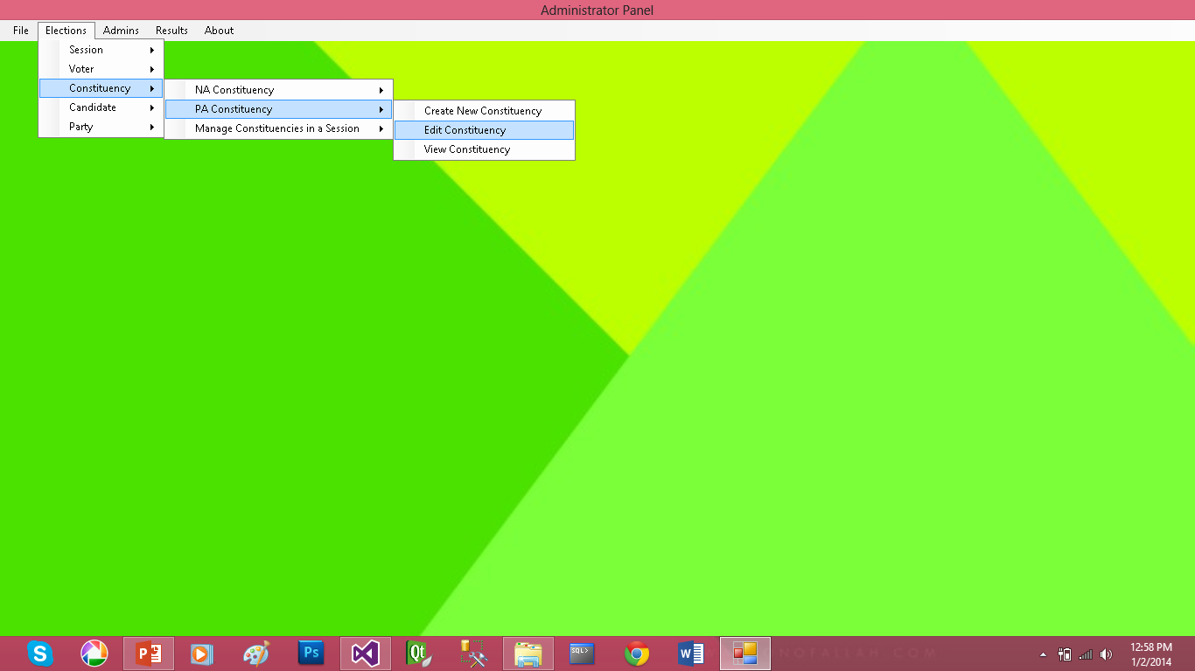

Admin panel

Slide 47


ECO panel

Slide 48


Slide 49

NA result

Slide 50

PA Result

